Slide 1

Web Application Vulnerabilities
19CSE335 Ethical Hacking

Slide 2
How Web Applications Work??
Web applications:- programs that reside on a web server to give the user functionality beyond just a website.
Ex: Database queries, webmail, discussion groups, and blogs
A web application uses a client/server architecture
Web browser as the client
Web server acting as the application server.
JavaScript is a popular way to implement web applications

Slide 3
Objectives of Web Application Hacking
Gain confidential data
Critical to the security of a system because they usually connect to a database that contains information such as identities with credit card numbers and passwords.
Hackers will exploit the operating system and web server or web application software

Slide 4
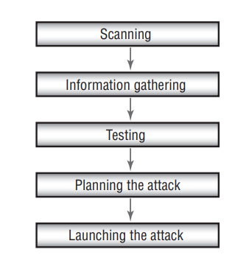
Anatomy of an Attack

Slide 5
Web Application Threats
Cross-site scripting
SQL injection
Command injection
Cookie poisoning and snooping
Buffer overflow
Authentication hijacking
Directory traversal / Unicode

Slide 6
Cross-site scripting: A parameter entered into a web form is processed by the web application. The correct combination of variables can result in arbitrary command execution.
SQL injection: Inserting SQL commands into the URL gets the database server to dump, alter, delete, or create information in the database.
Command injection: The hacker inserts programming commands into a web form.
Cookie poisoning and snooping: The hacker corrupts or steals cookies.
Buffer overflow: Huge amounts of data are sent to a web application through a web form to execute commands.
Authentication hijacking: The hacker steals a session once a user has authenticated.
Directory traversal/Unicode: The hacker browses through the folders on a system via a web browser or Windows explorer

Slide 7
Hacking Tools
Instant Source allows a hacker to see and edit HTML source code. It can be used directly from
within the web browser.
Wget is a command-line tool that a hacker can use to download an entire website, complete with all the files. The hacker can view the source code offline and test certain attacks prior to launching them against the real web server.
Web Sleuth uses spidering technology to index an entire website. For example, WebSleuth can pull all the e-mail addresses from different pages of a website.
Black Widow can scan and map all the pages of a website to create a profile of the site.
SiteScope maps out the connections within a web application and aids in the deconstruction of the program.
WS Digger is a web services testing tool that contains sample attack plug-ins for SQL injection, cross-site scripting, and other web attacks.
Burp is a Windows-based automated attack tool for web applications. It can also be used to guess passwords on web applications and perform man-in-the-middle attacks.

Slide 8
Google Hacking
Using Google’s powerful search engine to locate high-value targets or to search for valuable information such as passwords.
Many tools such as http://johnny.ihackstuff.com and Acunetix Web Vulnerability Scanner contain a list of Google hacking terms organized in a database, to make searching easier.

Slide 9
Web Application Countermeasures
Cross-site scripting :- Validate cookies, query strings, form fields, and hidden fields.
SQL injection :- Validate user variables.
Command injection Use language :- Specific libraries for the programming language.
Cookie poisoning and snooping :- Don’t store passwords in a cookie. Implement cookie timeouts and authenticate cookies.
Buffer overflow :- Validate user input length, and perform bounds checking
Authentication hijacking :- Use SSL to encrypt traffic.
Directory traversal / Unicode :- Define access rights to private folders on the web server.

